Slide 1




SUMMER TRAINING PRESENTATION
NAME - KARTIK BHATT
BRANCH - CSE - EVENING
ENROLLMENT-NO - 35196307221
ROLL-NO - 65
PROJECT - WEBSITE ON MAHARAJA SURAJMAL INSTITUTE OF TECHNOLOGY

Slide 2

THE PROGRAMING LANGUAGES USED ON THE WEBSITE ARE

Slide 3
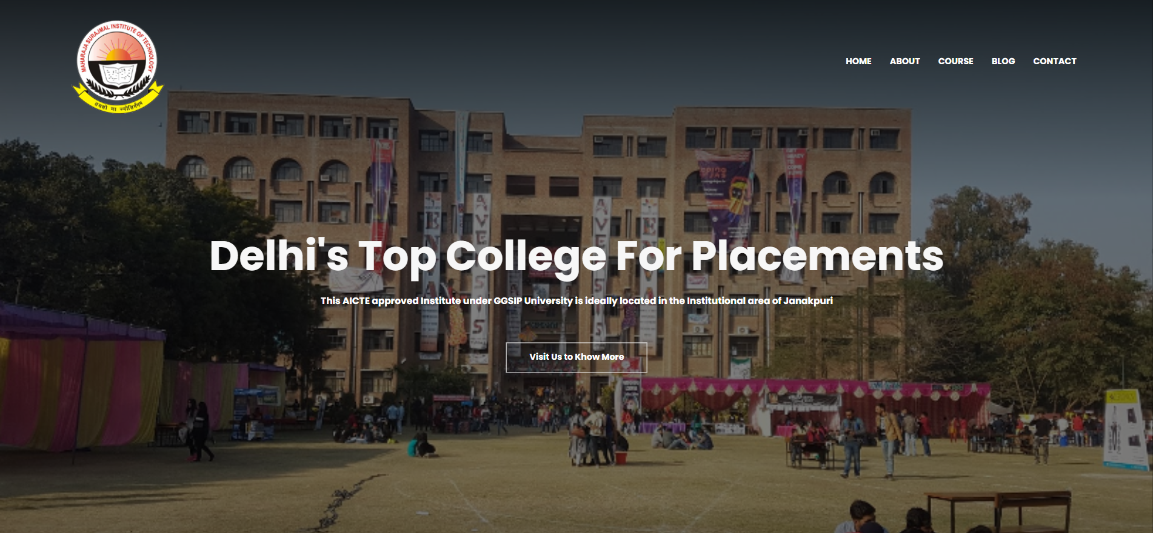
This is our home Page

Slide 4

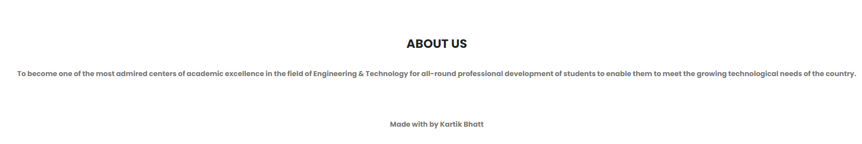
HOME SECTION
FOOTER SECTION

Slide 5
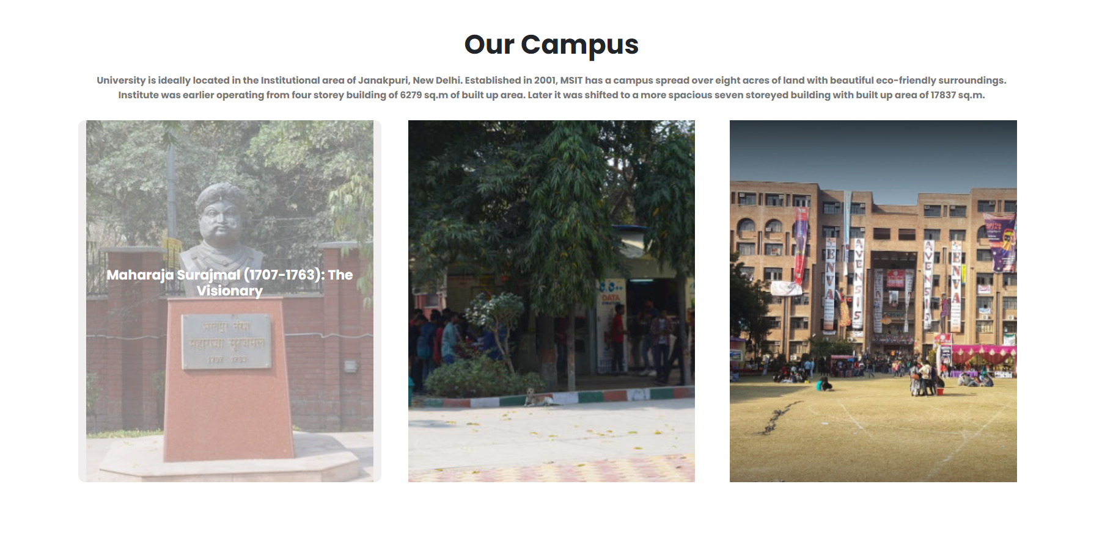
An Animated Page for Our Campus when we hover the cursor on the Image it Animates the Description

Slide 6
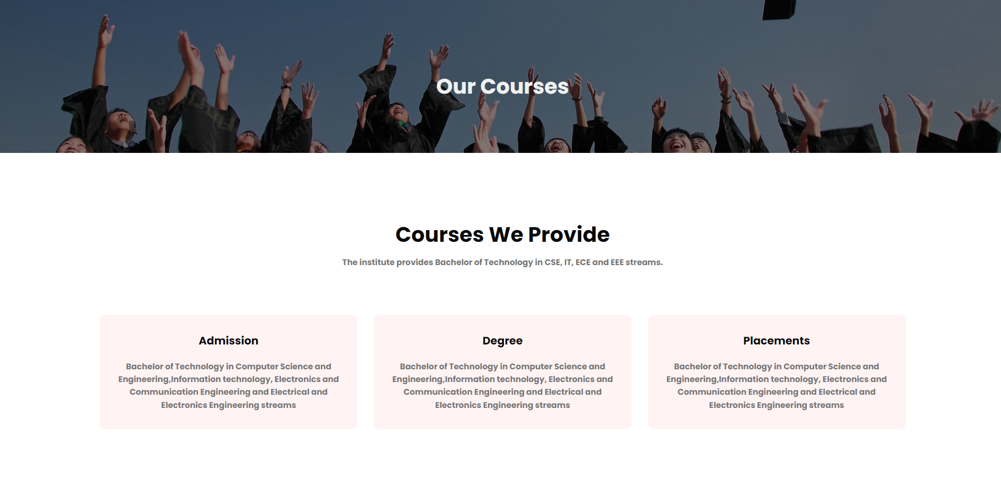
OUR COURSES PAGES

Slide 7
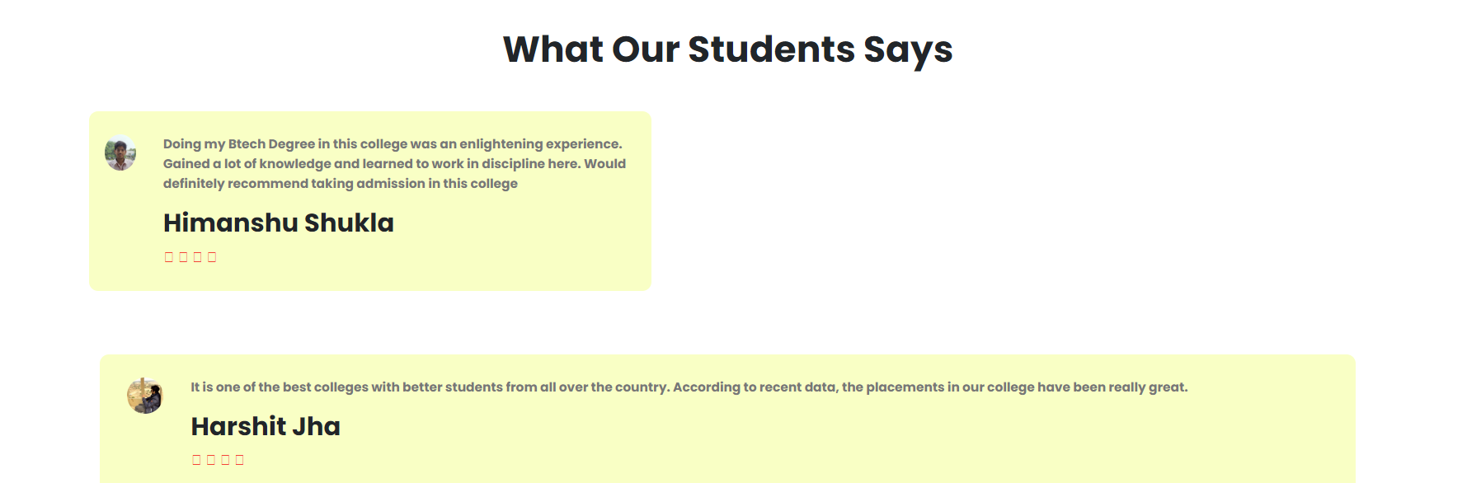
REVIEWS OF STUDENTS

Slide 8
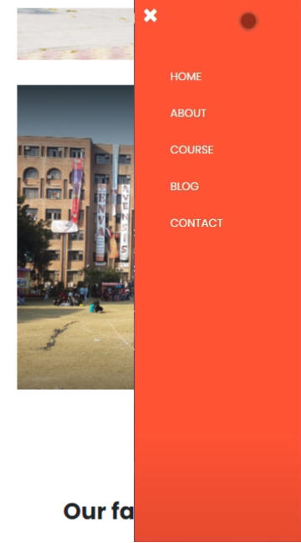
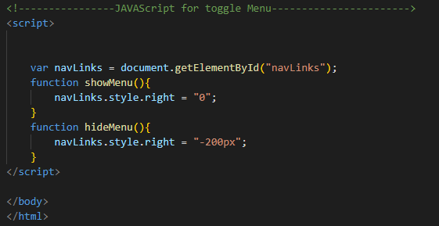
THE WEBSITE IS ALSO MOBILE SCREEN FRIENDLY WITH A FULLY FUNCTIONAL MENU BAR WITH THE HELP OF HAMBURGER MENU JAVA SCRIPT

Slide 9
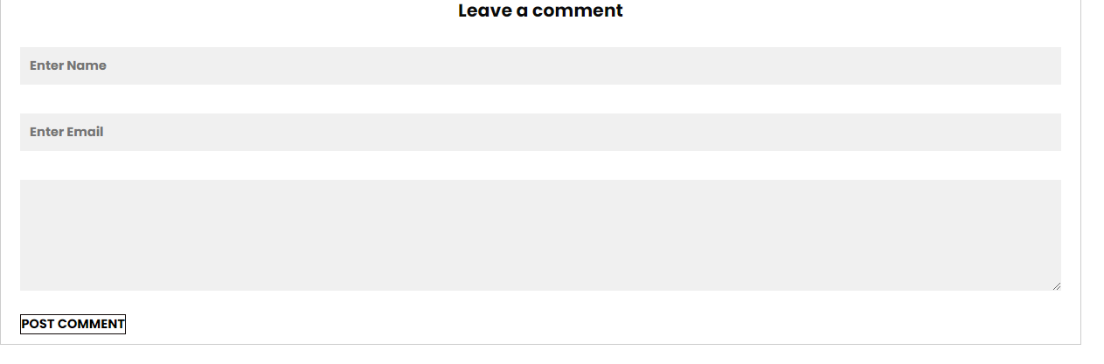
A VERY RESPONSIVE Leave-A-Comment Section FOR ALL THE QUERIES OF STUDENTS AND PARENTS

Slide 10
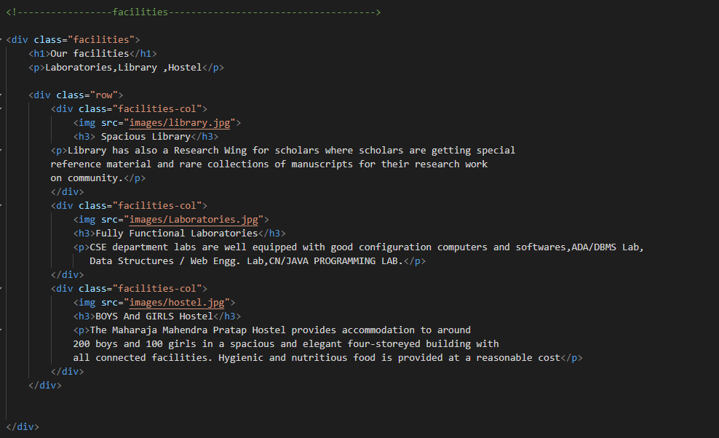
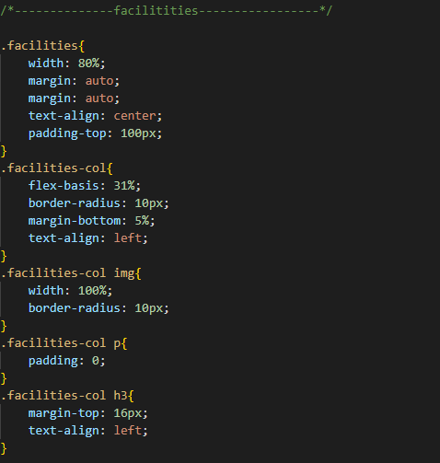
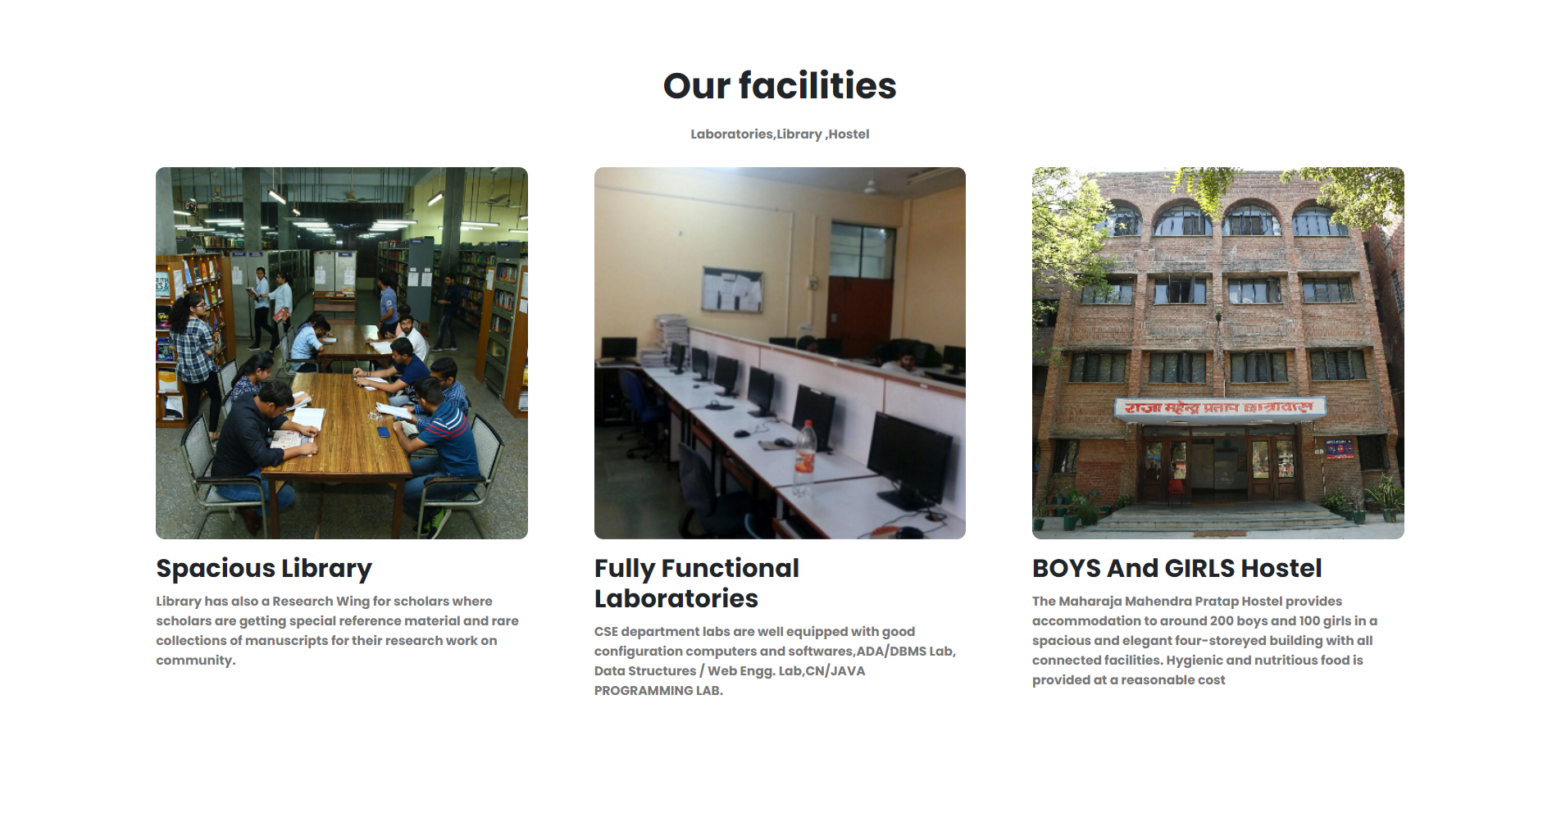
The CSS CODE used to add style to a web page by dictating how a site is displayed on a browser.
The HTML is the code that is used to structure a web page and its content
FINAL Implementation

Slide 11


WE USE VS-CODE IDE FOR CODING AND USE ITS VERY USE FULL PLUGINS TO MAKE EASY TO PROGRAM .
VS CODE HAVE A PLUGIN TO LOCAL HOST A WEBSIT ITH THE HELP OF GOOGLE CHROME WE CAN RUN OUR WEBSITE

Slide 12


HOW WE CAN IMPROVE A WEBSITE
CHAT BOT
Here are the top 5 reasons a chatbot will improve your college's website:
Efficiency.
Lead Capture Form Replacement.
24/7 Student Services
Human Hand-Off
Data Validation

Slide 13

THANK YOU
_/\_
KARTIK BHATT
CSE (EVENIING)
65
35196307221

